Slide 1
Everything about infnite rows is here

Slide 2

Addition of series:
$\frac{1}{1−x}=1+x+x^{2}+...$
$e^{x}=1+x+\frac{x^{2}}{2}+\frac{x^{3}}{3!}+...$
$\frac{1}{1−x}+e^{x}=2+2x+\frac{3}{2}x^{2}+\frac{7}{6}x^{3}=\sum_{n=0}^{∞}{\frac{n!+1}{n!}}x^{n}$

Slide 3
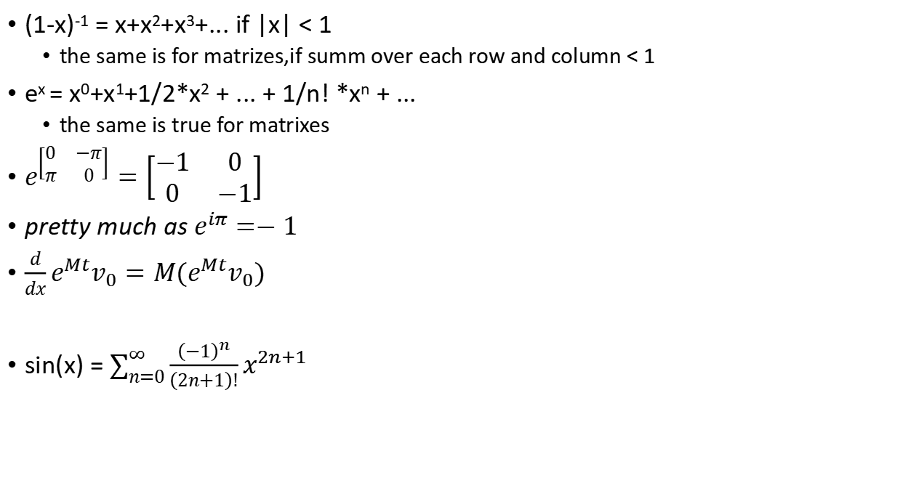
Infnite rows and matrixes
(1-x)⁻¹ = x+x²+x³+... if |x| < 1
the same is for matrizes,if summ over each row and column < 1
e^{x} = x⁰+x¹+1/2*x² + ... + 1/n! *x^{n} + ...
the same is true for matrixes
$e^{\left[\begin{matrix}0 & −π \\ π & 0\end{matrix}\right]}=\left[\begin{matrix}−1 & 0 \\ 0 & −1\end{matrix}\right]$
pretty much as $e^{iπ}=−1$
$\frac{d}{dx}e^{Mt}v_{0}=M(e^{Mt}v_{0})$
sin(x) = $\sum_{n=0}^{∞}{\frac{{\left(−1\right)}^{n}}{\left(2n+1\right)!}x^{2n+1}}$

Slide 4
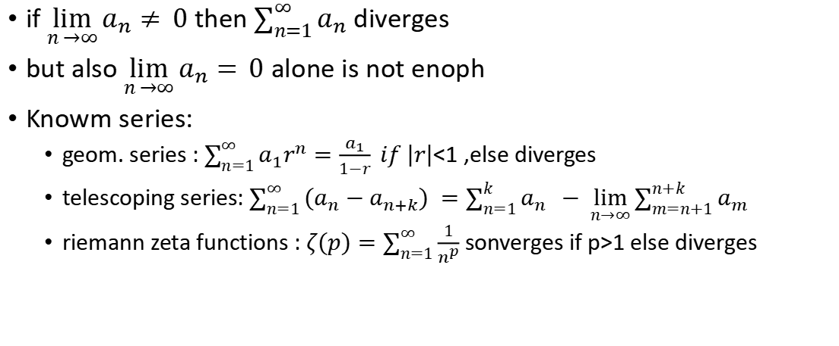
Test for divergence (TFD)
if $\lim_{n →∞}{a_{n}≠} 0$ then $\sum_{n=1}^{∞}{a_{n}}$ diverges
but also $\lim_{n →∞}{a_{n}=} 0$ alone is not enoph
Knowm series:
geom. series : $\sum_{n=1}^{∞}{a_{1}r^{n}=\frac{a_{1}}{1−r} if \left|r\right|}$<1 ,else diverges
telescoping series: $\sum_{n=1}^{∞}{(a_{n}−a_{n+k}) =\sum_{n=1}^{k}{a_{n}}} − \lim_{n→∞}{\sum_{m=n+1}^{n+k}{a_{m}}}$
riemann zeta functions : $ζ(p)=\sum_{n=1}^{∞}{\frac{1}{n^{p}}}$ sonverges if p>1 else diverges

Slide 5

Examples
3/5 , -1/5 , 1/15, - 1/45 , 1/135
$a_{n}=\frac{3}{5}\left(\frac{−1}{3}\right)$^{n} d
$\lim_{n→∞}{a_{n} = }\lim_{n→∞}{\frac{3}{5}∗0 = 0}$
$\sum_{n=1}^{∞}{a_{n}=\frac{\frac{3}{5}}{1−\frac{−1}{3}}}=\frac{9}{20}$ (converges)
7/15 , 8/19 , 9/23, 10/27, 11/31
$a_{n}=\frac{7+n}{15+4n}$
$\lim_{n→∞}{a_{n} = }\frac{\frac{7}{n}+1}{\frac{15}{n}+4}=\frac{1}{4}$ (diverges)

Slide 6
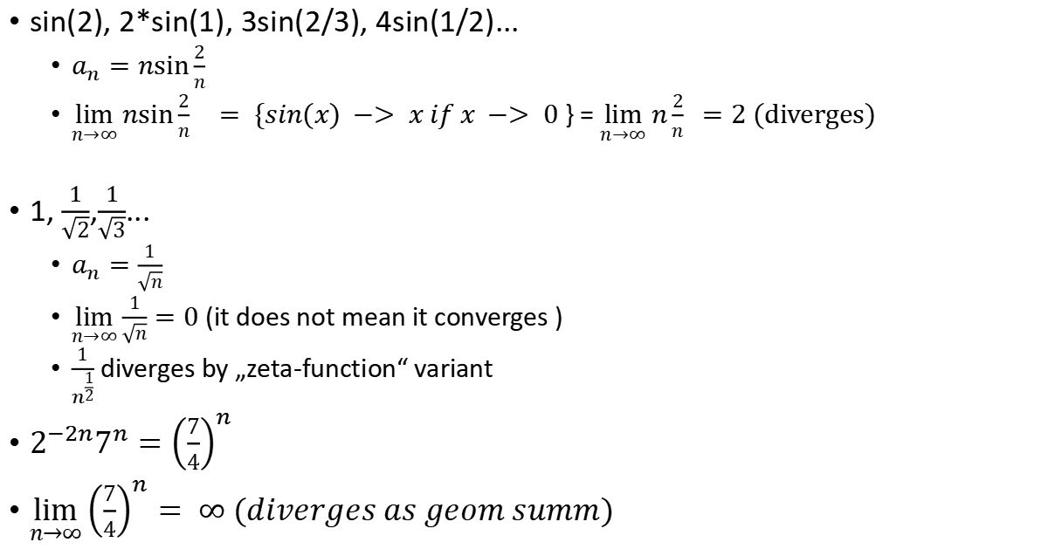
Examples 2
sin(2), 2*sin(1), 3sin(2/3), 4sin(1/2)...
$a_{n}=n\sin{\frac{2}{n}}$
$\lim_{n→∞}{n\sin{\frac{2}{n}} } = \{sin(x) −> x if x −> 0$} = $\lim_{n→∞}{n\frac{2}{n} }=2 (diverges)$
1, $\frac{1}{\sqrt{2}}$,$\frac{1}{\sqrt{3}}$...
$a_{n}=\frac{1}{\sqrt{n}}$
$\lim_{n→∞}{\frac{1}{\sqrt{n}}=0 }$(it does not mean it converges )
$\frac{1}{n^{\frac{1}{2}}}$ diverges by „zeta-function“ variant
$2^{−2n}7^{n}={\left(\frac{7}{4}\right)}^{n}$
$\lim_{n→∞}{{\left(\frac{7}{4}\right)}^{n}}= ∞ (diverges as geom summ)$

Slide 7

Examples 3
$a_{n}={\left(1−\frac{1}{n}\right)}^{n}$
$\lim_{n→∞}{{\left(1−\frac{1}{n}\right)}^{n}}= e^{−1 }$(diverges) {${\left(1+\frac{a}{n}\right)}^{bn}=e^{ab}$}
$a_{n}=\frac{1}{\sqrt{n}+\sqrt{n+1}}=\frac{\sqrt{n}−\sqrt{n+1}}{n−\left(n+1\right)}=\sqrt{n+1}−\sqrt{n}$
$\lim_{n→∞}{\frac{1}{\sqrt{n}+\sqrt{n+1}}}=\frac{1}{∞}=0$
$\sum_{n=1}^{∞}{−\sqrt{n}+\sqrt{n+1}}=−1+\lim_{n→∞}{\sqrt{n+2}}→∞(diverges)$

Slide 8
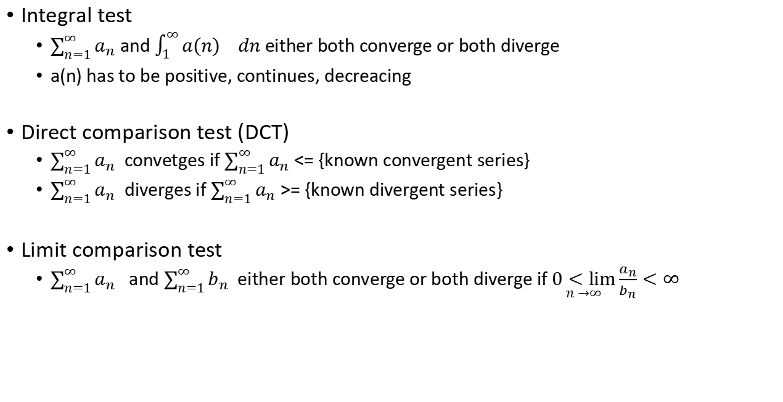
Test for divergence 2
Integral test
$\sum_{n=1}^{∞}{a_{n}}$ and $\int_{1}^{∞}{{a(n)}_{}}dn$either both converge or both diverge
a(n) has to be positive, continues, decreacing
Direct comparison test (DCT)
$\sum_{n=1}^{∞}{a_{n}}$ convetges if $\sum_{n=1}^{∞}{a_{n}}$ <= {known convergent series}
$\sum_{n=1}^{∞}{a_{n}}$ diverges if $\sum_{n=1}^{∞}{a_{n}}$ >= {known divergent series}
Limit comparison test
$\sum_{n=1}^{∞}{a_{n}}$ and $\sum_{n=1}^{∞}{b_{n}}$ either both converge or both diverge if $\underset{n →∞}{0<lim}{\frac{a_{n}}{b_{n}}}<∞$

Slide 9

Examples
1/3 + 1/8 + 1/15 + 1/24 = 1/(1*3) + 1/(2*4) + 1/(3*5) + 1/(4*6) + ...= 1/(n(n+2)
apply the integral test:
$\frac{1}{2}\int_{1}^{∞}{(\frac{1}{n}}−\frac{1}{n+2})dn=\frac{1}{2}\ln{x}−\frac{1}{2}\ln{(x+2) |_{1}^{∞}}=\frac{1}{2}\ln{\frac{x}{x+2}} |_{1}^{∞}$ (1)
$\lim_{x →∞}{\ln{\frac{x}{x+2}}}=ln 1 = 0$
so (1) = 0-$\frac{1}{2}ln{\frac{1}{1+2}}$= $\frac{1}{2}$ $ln$3 -> means that summ also converges

Slide 10
Examples
1/2 + 4/9 + 9/28 + 16/65 = n²/(n³+1)
DCT:
n²/(n³+1) < 1/p, so it is unknown
Limit comparison test:
lim (n²/(n³+1) : 1/n) = lim (n³/(n³+1) ) = 1. Because 1/n diverges, this also diverges
1/ln2⁴ + 1/ln3⁹ + 1/ln4¹⁶ + 1/ln5²⁵ = 1/ln(n^{n^2}) ) 1 / (n²ln n)
remember : ln n << n^{p} << p ^{n} << n! as n-> inf
DCT: to 1/n2 :(1) <= 1/n² and 1/n² converges, so (1) also converges, but:
sum(1/n2) = Zeta(2)= pi2/6
!! ->not sure when n = 2 because ln 2 < 0, but true for n >= 3

Slide 11
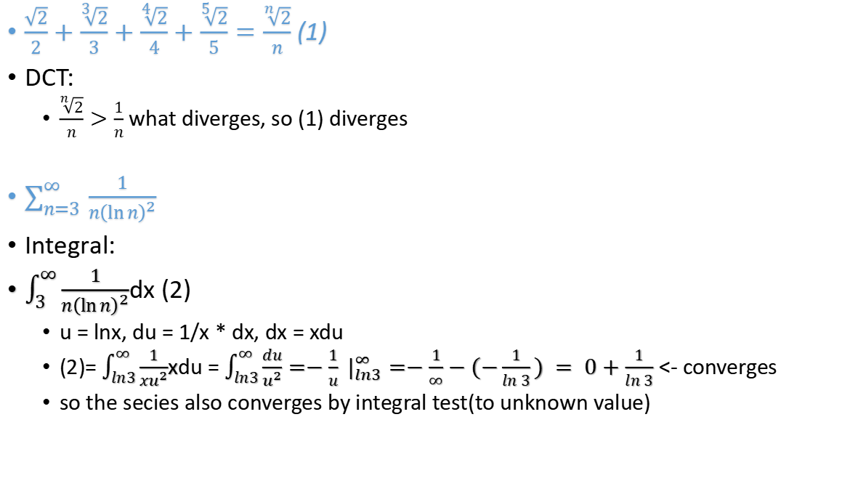
$\frac{\sqrt{2}}{2}+\frac{\sqrt[3]{2}}{3}+\frac{\sqrt[4]{2}}{4}+\frac{\sqrt[5]{2}}{5}=\frac{\sqrt[n]{2}}{n}$ (1)
DCT:
$\frac{\sqrt[n]{2}}{n}>\frac{1}{n}$ what diverges, so (1) diverges
$\sum_{n=3 }^{∞}{\frac{1}{n{\left(\ln{n}\right)}^{2}}}$
Integral:
$\int_{3}^{∞}{\frac{1}{n{\left(\ln{n}\right)}^{2}}}$dx (2)
u = lnx, du = 1/x * dx, dx = xdu
(2)= $\int_{ln3}^{∞}{\frac{1}{xu^{2}}}$xdu = $\int_{ln3}^{∞}{\frac{du}{u^{2}}}=−\frac{1}{u} |_{ln3}^{∞}=−\frac{1}{∞}−(−\frac{1}{ln 3}) = 0+\frac{1}{ln 3}$ <- converges
so the secies also converges by integral test(to unknown value)

Slide 12
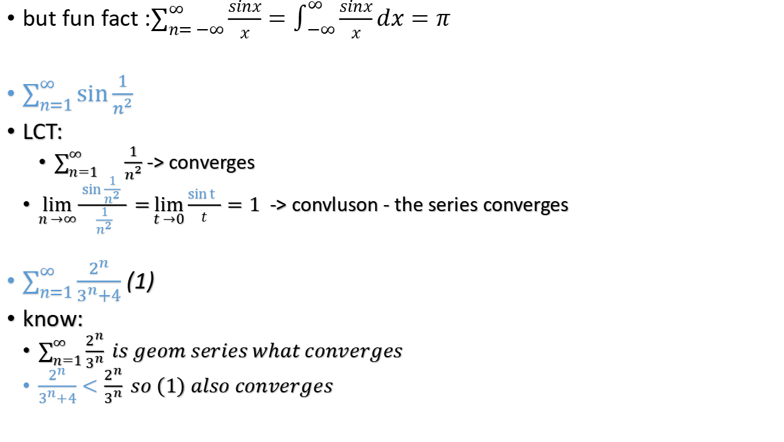
but fun fact :$\sum_{n= −∞}^{∞}{\frac{sinx}{x}}=\int_{ −∞}^{∞}{\frac{sinx}{x}}dx=π$
$\sum_{n=1}^{∞}{\sin{\frac{1}{n^{2}}}}$
LCT:
$\sum_{n=1}^{∞}{{\frac{1}{n^{2}}}}$ -> converges
$\lim_{n →∞}{\frac{\sin{\frac{1}{n^{2}}} }{\frac{1}{n^{2}}}}=\lim_{t →0}{\frac{\sin{t} }{t}}=1$-> convluson - the series converges
$\sum_{n=1}^{∞}{\frac{2^{n}}{3^{n}+4}}$ (1)
know:
$\sum_{n=1}^{∞}{\frac{2^{n}}{3^{n}}} is geom series what converges$
$\frac{2^{n}}{3^{n}+4}<\frac{2^{n}}{3^{n}} so (1) also converges$

Slide 13

$\sum_{n=3}^{∞}{\frac{1}{n\sqrt{\ln{n}}}}$
Integral test:$\int_{x=3}^{∞}{\frac{1}{x\sqrt{\ln{x}}}dx}=(1)$
substitution:
u = ln x
du = $\frac{dx}{x}$
dx = xdu
$(1)$ = $\int_{u=ln3}^{∞}{\frac{1}{x\sqrt{u}}}xdu=\int_{u=ln3}^{∞}{\frac{1}{\sqrt{u}}}du=2\sqrt{u}|_{ln3}^{∞}=2\sqrt{∞}−2\sqrt{ln3}→∞$
conclusion_ the sequence diverges

Slide 14

$\sum_{n=1}^{∞}{\frac{1}{n\sqrt{n}}}$
$\sum_{n=1}^{∞}{\frac{1}{n^{\frac{3}{2}}}}= Zeta(\frac{3}{2})$ ( converges if p > 1
$\sum_{n=1}^{∞}{\frac{1}{n+\sqrt{n}}}$
$\sum_{n=1}^{∞}{\frac{1}{n+\sqrt{n}}}> \sum_{n=1}^{∞}{\frac{1}{n+n}}=\frac{1}{2}\{harmonic series\} −> diverges$

Slide 15
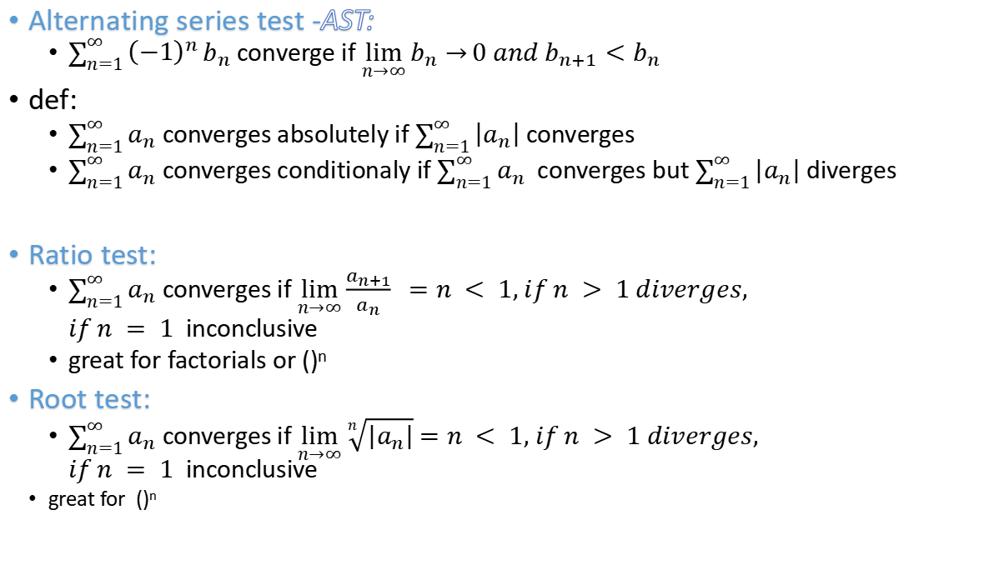
Alternating series test -AST:
$\sum_{n=1}^{∞}{{\left(−1\right)}^{n}}b_{n}$ converge if $\lim_{n→∞}{b_{n}→}0 and b_{n+1}<b_{n}$
def:
$\sum_{n=1}^{∞}{a_{n}}$ converges absolutely if $\sum_{n=1}^{∞}{\left|a_{n}\right|}$ converges
$\sum_{n=1}^{∞}{a_{n}}$ converges conditionaly if $\sum_{n=1}^{∞}{a_{n}}$ converges but $\sum_{n=1}^{∞}{\left|a_{n}\right|}$ diverges
Ratio test:
$\sum_{n=1}^{∞}{a_{n}}$ converges if $\lim_{n→∞}{\frac{a_{n+1}}{a_{n}}} =n < 1, if n > 1 diverges,$ $if n = 1$inconclusive
great for factorials or ()^{n}
Root test:
$\sum_{n=1}^{∞}{a_{n}}$ converges if $\lim_{n→∞}{\sqrt[n]{\left|a_{n}\right|}}$ $=n < 1, if n > 1 diverges,$ $if n = 1$inconclusive
great for ()^{n}

Slide 16
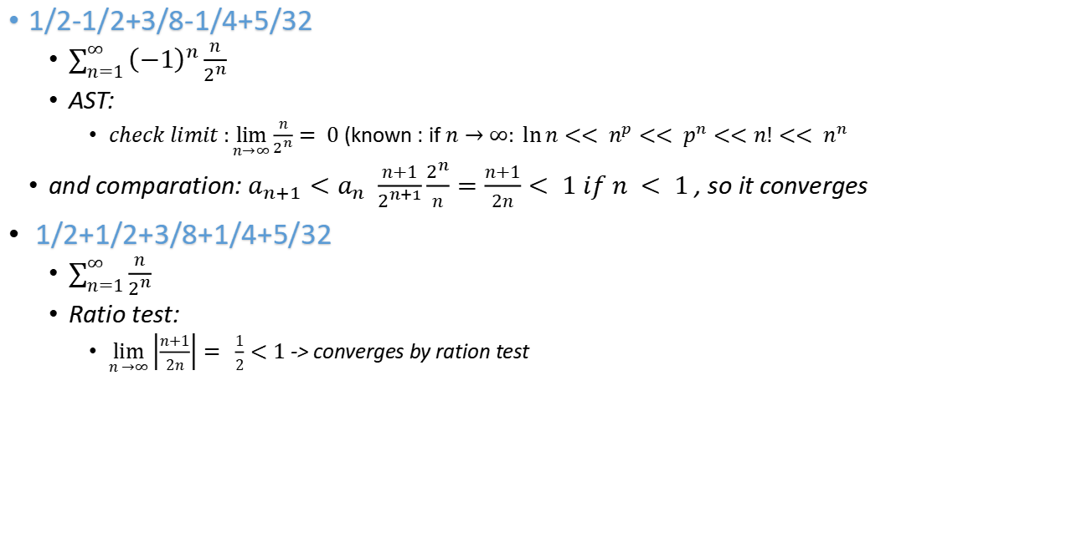
Examples - Secont geom series
1/2-1/2+3/8-1/4+5/32
$\sum_{n=1}^{∞}{{\left(−1\right)}^{n}}\frac{n}{2^{n}}$
AST:
$check limit :\lim_{n→∞}{\frac{n}{2^{n}}}= 0$ (known : if $n→∞: \ln{n}<< n^{p}<< p^{n}<<n!<< n^{n}$
and comparation:$a_{n+1}<a_{n}$ $\frac{n+1}{2^{n+1}}\frac{2^{n}}{n}=\frac{n+1}{2n}< 1 if n < 1$ , so it converges
1/2+1/2+3/8+1/4+5/32
$\sum_{n=1}^{∞}{\frac{n}{2^{n}}}$
Ratio test:
$\lim_{n →∞}\left|\frac{n+1}{2n}\right|= \frac{1}{2}<1$ -> converges by ration test

Slide 17
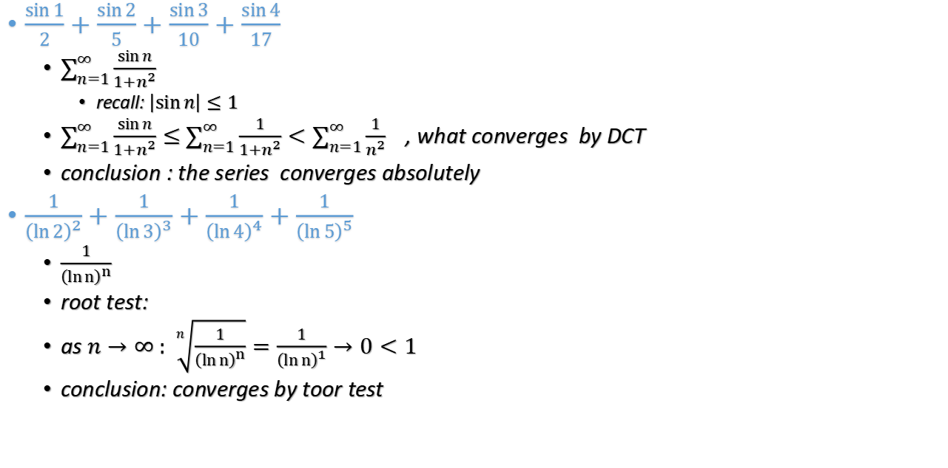
$\frac{\sin{1}}{2}+\frac{\sin{2}}{5}+\frac{\sin{3}}{10}+\frac{\sin{4}}{17}$
$\sum_{n=1}^{∞}{\frac{\sin{n}}{1+n^{2}}}$
recall: $\left|\sin{n}\right|≤1$
$\sum_{n=1}^{∞}{\frac{\sin{n}}{1+n^{2}}}≤$ $\sum_{n=1}^{∞}{\frac{1}{1+n^{2}}}<\sum_{n=1}^{∞}{\frac{1}{n^{2}}}$, what converges by DCT
conclusion : the series converges absolutely
$\frac{1}{{\left(\ln{2}\right)}^{2}}+\frac{1}{{\left(\ln{3}\right)}^{3}}+\frac{1}{{\left(\ln{4}\right)}^{4}}+\frac{1}{{\left(\ln{5}\right)}^{5}}$
$\frac{1}{{\left(\ln{n}\right)}^{n}}$
root test:
as $n→∞ : \sqrt[n]{\frac{1}{{\left(\ln{n}\right)}^{n}}}=\frac{1}{{\left(\ln{n}\right)}^{1}}→0<1$
conclusion: converges by toor test

Slide 18

$\sum_{n=1}^{∞}{{\left(−1\right)}^{n}}\frac{1}{\sqrt{3n+1}}$
AST:
check: as n -> $∞ :$ $\frac{1}{\sqrt{3n+1}} = 0$
check$: b_{n+1}<b_{n}$: $\frac{1}{\sqrt{3n+4}}<\frac{1}{\sqrt{3n+1}}$ - true
conclusion : the series converges
$\sum_{n=1}^{∞}{\frac{1}{\sqrt{3n+1}}}$
$\frac{1}{\sqrt{3n+1}}>\frac{1}{n}$ ,
conclusion : it is bigger then harmonic series what diverges

Slide 19
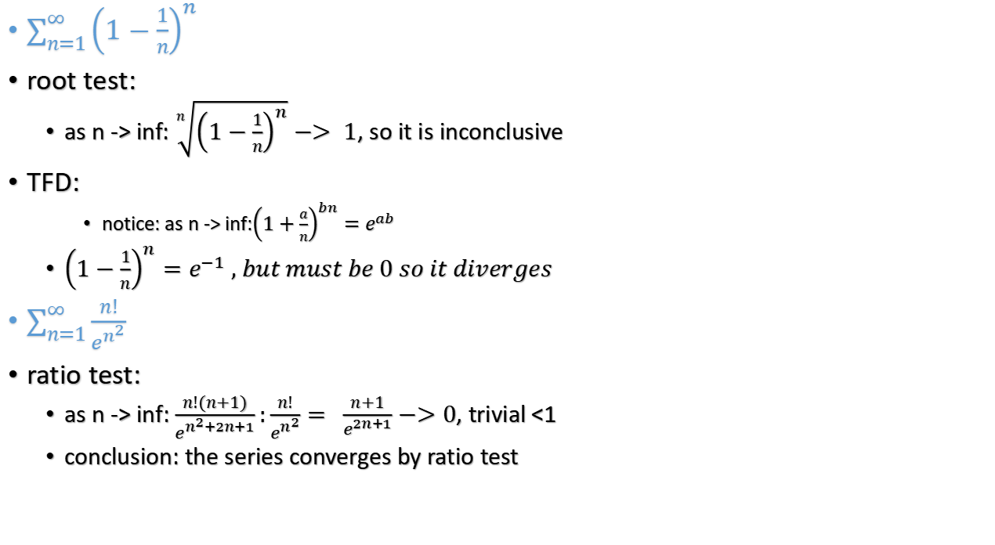
$\sum_{n=1}^{∞}{{\left(1−\frac{1}{n}\right)}^{n}}{}$
root test:
as n -> inf: $\sqrt[n]{{\left(1−\frac{1}{n}\right)}^{n}}−> 1$, so it is inconclusive
TFD:
notice: as n -> inf:${\left(1+\frac{a}{n}\right)}^{bn}=e^{ab}$
${\left(1−\frac{1}{n}\right)}^{n}=e^{−1} , but must be 0 so it diverges$
$\sum_{n=1}^{∞}{\frac{n!}{e^{n^{2}}}}$
ratio test:
as n -> inf: $\frac{n!(n+1)}{e^{n^{2}+2n+1}}:\frac{n!}{e^{n^{2}}}= \frac{n+1}{e^{2n+1}}−>0$, trivial <1
conclusion: the series converges by ratio test

Slide 20
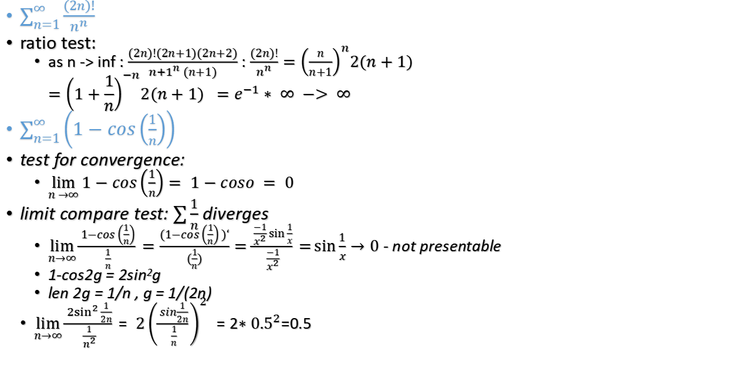
$\sum_{n=1}^{∞}{\frac{(2n)!}{n^{n}}}$
ratio test:
as n -> inf : $\frac{(2n)!(2n+1)(2n+2)}{{n+1}^{n} (n+1)}$ : $\frac{(2n)!}{n^{n}}={\left(\frac{n}{n+1}\right)}^{n}2(n+1)$ $$={\left(1+\frac{1}{n}\right)}^{−n}2(n+1) =e^{−1}∗ ∞ −> ∞$$
$\sum_{n=1}^{∞}{\left(1−cos\left(\frac{1}{n}\right)\right)}$
test for convergence:
$\lim_{n →∞}{1−cos\left(\frac{1}{n}\right)= 1−coso = 0}$
limit compare test: $\sum{\frac{1}{n}}$ diverges
$\lim_{n→∞}{\frac{1−cos\left(\frac{1}{n}\right)}{\frac{1}{n}}}=\frac{(1−cos\left(\frac{1}{n}\right))‘}{(\frac{1}{n})}=\frac{\frac{−1}{x^{2}}sin{\frac{1}{x}}}{\frac{−1}{x^{2}}}=\sin{\frac{1}{x}}→0$ - not presentable
1-cos2g = 2sin²g
len 2g = 1/n , g = 1/(2n)
$\lim_{n→∞}{\frac{{2sin}^{2}{\frac{1}{2n}}}{\frac{1}{n^{2}}}= {2\left(\frac{sin\frac{1}{2n}}{\frac{1}{n}}\right)}^{2} =2{∗0.5}^{2}}$=0.5

Slide 21

give examples for :
series $\sum{a_{n}}$, so that Ratio test will rive inconclusive
$\sum{1}$, $\sum{\frac{1}{n^{p}}}$, ratio test = 1
$a_{n}≠0$, but $\sum{a_{n}}= 0$
sinx = $\sum_{n=0}^{∞}{\frac{{\left(−1\right)}^{n}x^{2n+1}}{\left(2n+1\right)!}}$
0 = sin$π$ = $\sum_{n=0}^{∞}{\frac{{\left(−1\right)}^{n}π^{2n+1}}{\left(2n+1\right)!}}$

Slide 22

Strange series
what is a formula for series 1,-1,0,0,0, - ?
answer: $\frac{2}{\sqrt{3}}sin(\frac{2πn!}{3})$

Slide 23

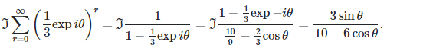

Slide 24
Sources
blackpenredpen Series Are NOT Scary
https://www.youtube.com/watch?v=Mj7AcP_wNvw
Series Are NOT Scary (part 3)
https://www.youtube.com/watch?v=jD4gxwV8SKQ

